Slide 1

Book Recommendation System
Team-1
Medidi Jayanth Rama Krishna
Konka Rohan
Uzra Furqan
Dara Arjun Kumar
Neehan Viren Aiya
Ventatesh Salmeta
Mentor’s name:
karthik muskula & dhanyapriya

Slide 2
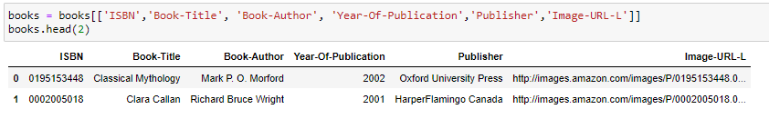
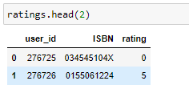
Datasets Overview

Slide 3
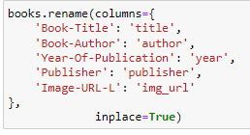

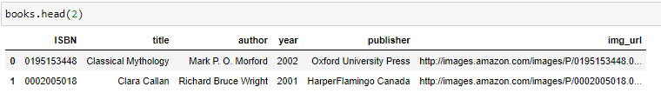
Operations on dataset

Slide 4
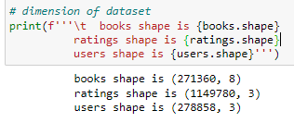
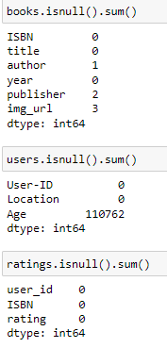
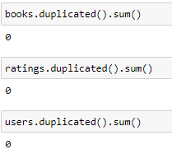
Details of datasets

Slide 5
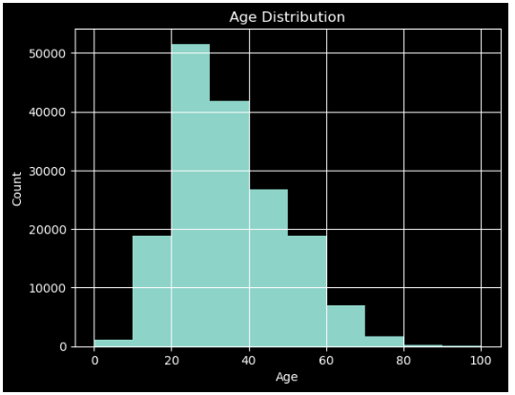
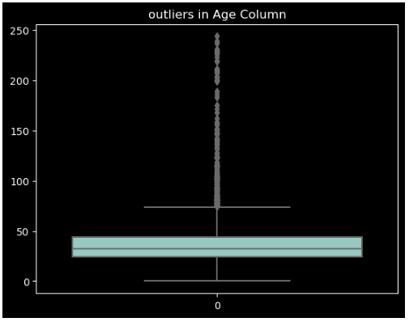
User Dataset

Slide 6
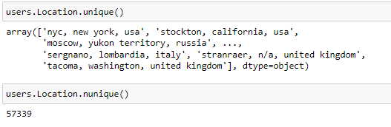
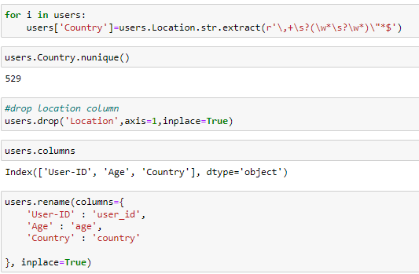
Continue…
57339 unique Value it's really hard to understand So we create Country column and drop location column

Slide 7
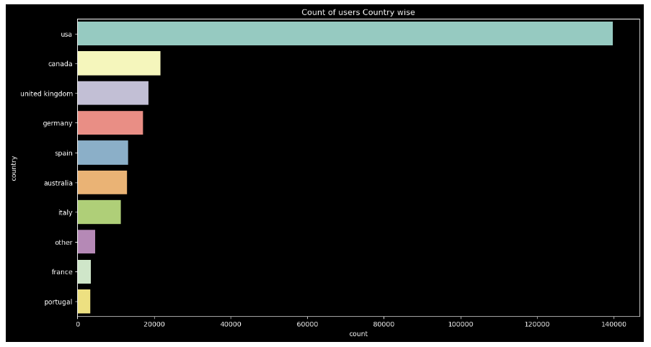
Country-wise user count

Slide 8
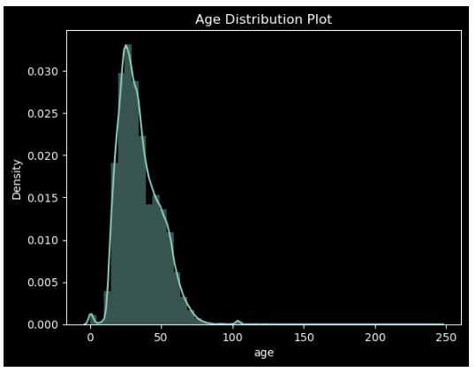
Age distribution Plot
Age value's below 5 and above 80 do not make much sense for our book rating case, hence we can replace these by NaN.
Age has positive Skewness (right tail) so we can use median to fill Nan values, but for this we don't like to fill Nan value just for one range of age. To handle this we'll use country column to fill Nan

Slide 9
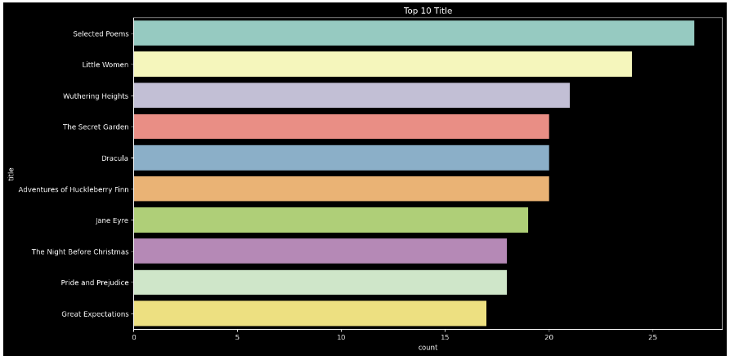
Book Dataset

Slide 10
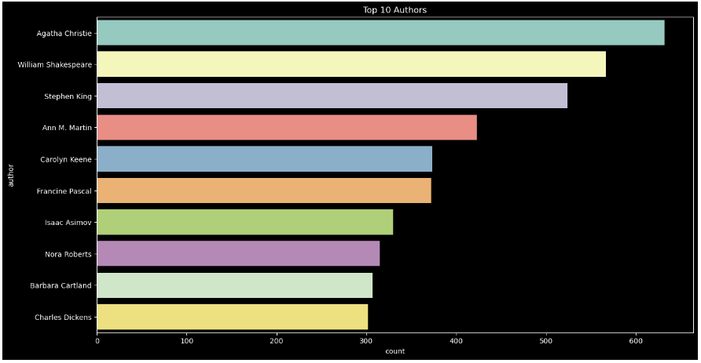
Continue…

Slide 11
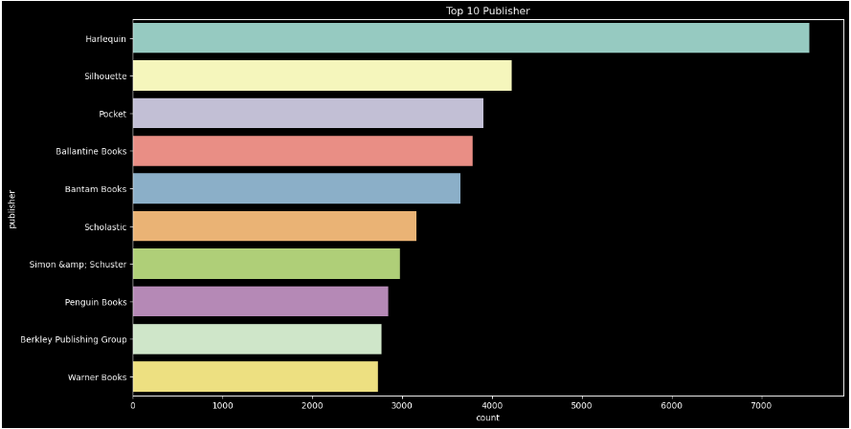
Continue…

Slide 12
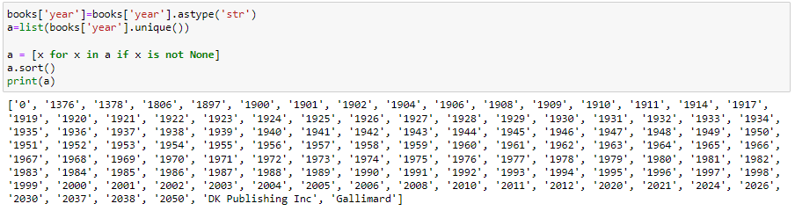
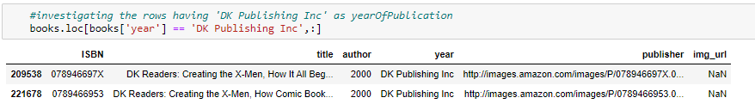
Continue…

Slide 13
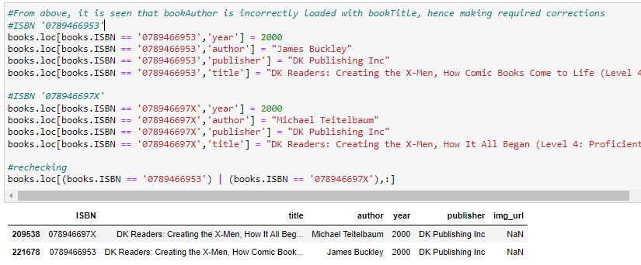
Continue…

Slide 14
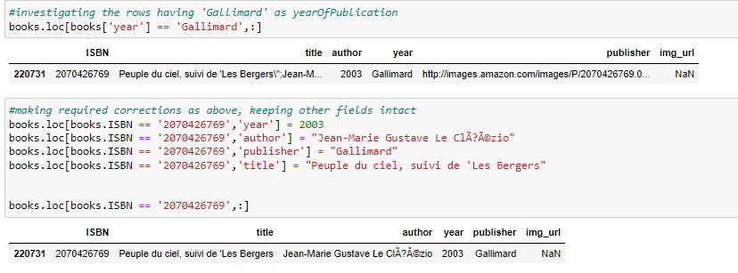
Continue…

Slide 15
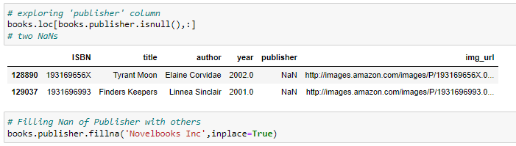
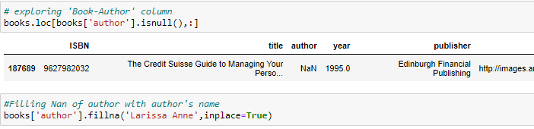
Continue…

Slide 16

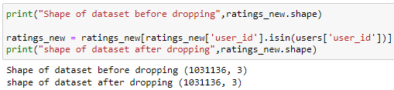
Rating Dataset
It can be seen that many rows having book ISBN not part of books dataset, got dropped off.
Ratings dataset should have ratings from users which exist in users dataset.
It can be seen that no new user was there in ratings dataset.

Slide 17
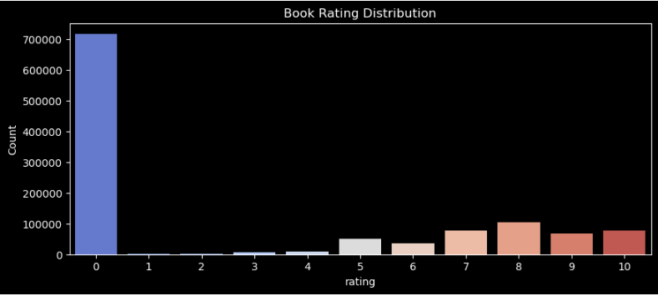
Book rating distribustion
The ratings are very unevenly distributed. Ratings are either explicit, expressed on a scale from 1-10 higher values denoting higher appreciation, or implicit, expressed by 0.
Hence we have to segregate implicit and explicit ratings datasets.

Slide 18
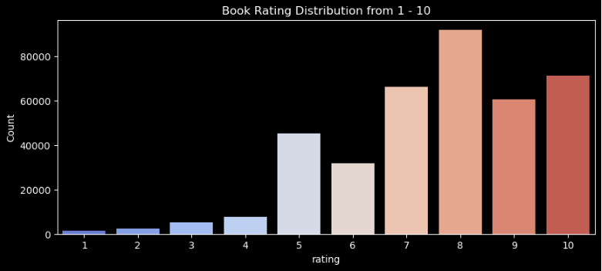
Explicit Book Rating distribution

Slide 19
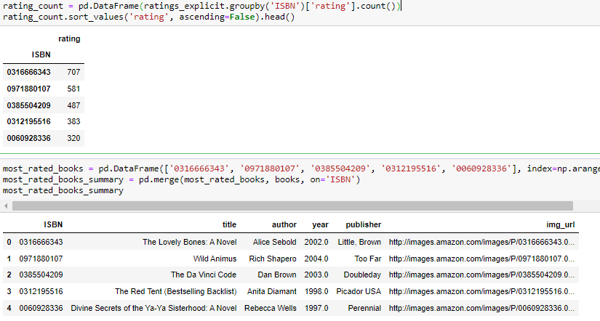
Top 5 books rated by most number of users.
The book that received the most rating counts in this data set is Rich Shapero’s “Wild Animus”.
There is something in common among these five books that received the most rating counts — they are all novels.
So it is conclusive that novels are popular and likely receive more ratings.

Slide 20
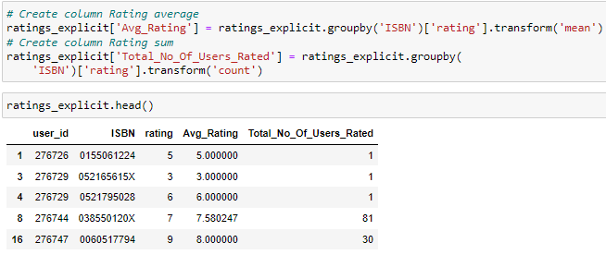
Average Rating

Slide 21
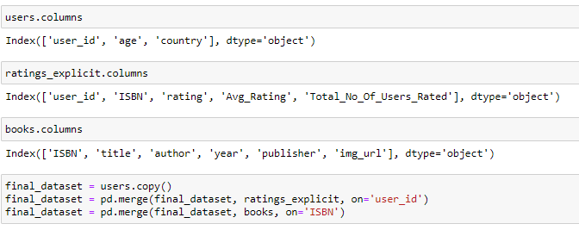
Merging all datasets

Slide 22
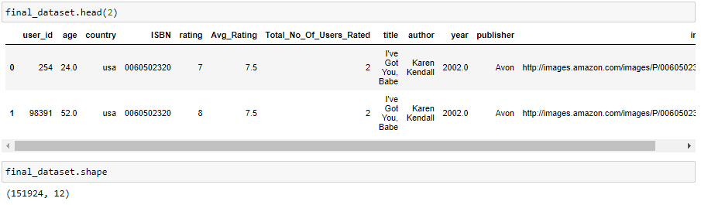
Continue…

Slide 23
THANK YOU

